Slide 1
DEMAND PLANING ANALYSIS
ELIZABETH MAKAU

Slide 2
Data cleaning and transformation
Converted mixed date formats into proper Excel dates
Created date dimension. Month, Month number, Year, YearMonth and Day.
Added Customer Name, Sales Channels, Product Name, Brand, Unit price, Sales Values using XLOOKUP
Created Week number and Quarter week for the weekly analysis
Handled missing data :blank sales channels to unknowm and unmatched codes to Not found

Slide 3
KEY ISSUE IN RAW DATA
Mixed date formats caused errors in extracting month/day/week
Some sales channels were blank which affected summary by channel
One of the Customer code was missing

Slide 4
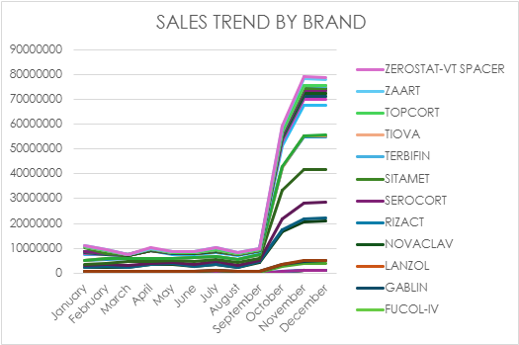
SALES TRENDS BY BRAND

Slide 5
SALES TREND BY BRAND
Sales remain relative stable for most of the year but increases significantly from October to December indicating a strong end of year demand.

Slide 6
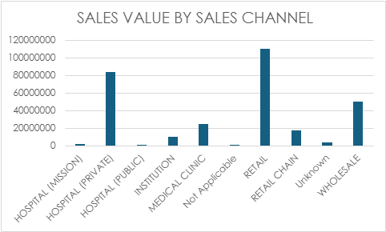
SALES VALUE BY SALES CHANNEL

Slide 7
SALES VALUE BY SALES CHANNEL
The bar graph indicate that retail sales channel generates the highest sales value compared to other channels , suggesting it is the most effective distribution channel.

Slide 8
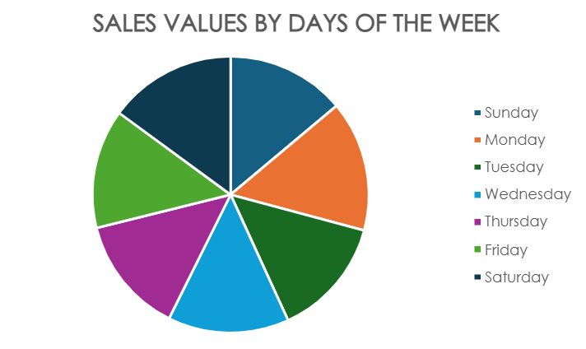
NO OF TRANSACTIONS BY DAY OF THE WEEK

Slide 9
NO OF TRANSACTIONS BY DAY OF THE WEEK
The pie chart shows how the sales are distributed across diffrent days of the week. Monday represents the day with the highest sales activity.

Slide 10
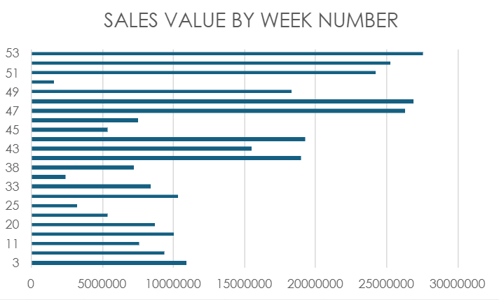
SALES VALUE BY WEEK NUMBER

Slide 11
SALES VALUES BY WEEK NUMBER
The chart shows the variation in sales values across diffrent weeks of the year. Some weeks recorded significantly higher sales compared to others.Week 53 had the highest sales.

Slide 12
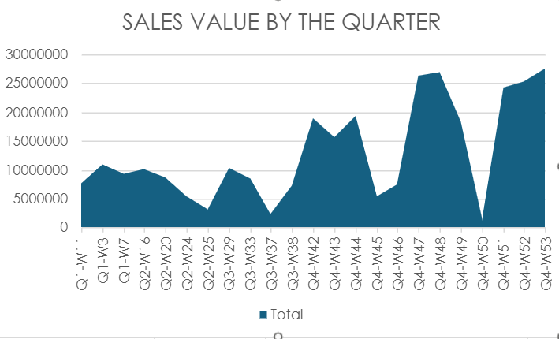
SALES VALUE BY THE QUARTER

Slide 13
SALES VALUE BY THE QUARTER
The area chart shows the trend of total sales across diffrent weeks of the year grouped by quartes. Q4 week 53 had the highest number of sales.

Slide 14
THANKS!!
Thanks!

